Slide 1


Medical Prescription Detection and Health Guidance System Using Machine Learning
22_23-J-73

Slide 2
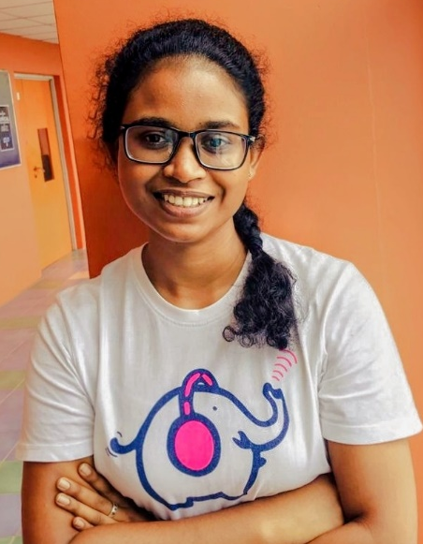
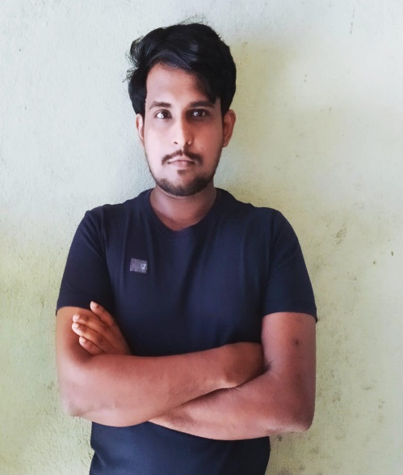
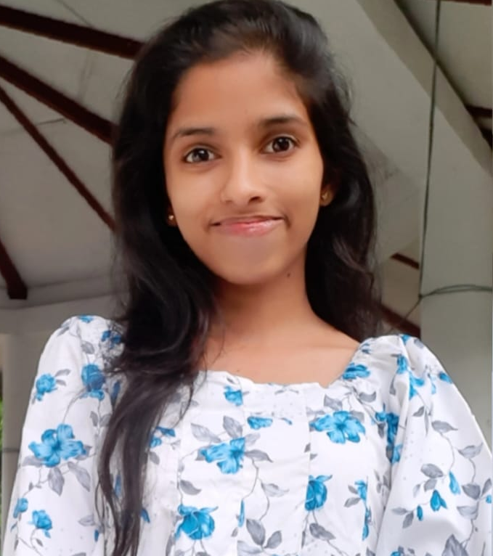
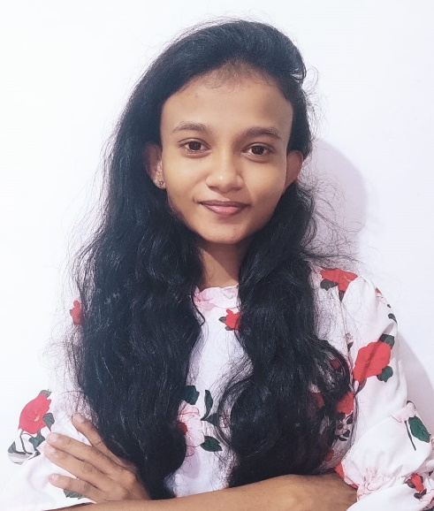
Our Team
Supervisor | Mr. Ravi Supunya
Co-supervisor | Ms. P.K. Suriya Kumari
IT18006544
IT18001112
IT18009132
IT18007848
Hewapathirana L.L
Mallawaarachchi T.S
Samaranayaka S.W
Jayangika D.H.K.C

Slide 3
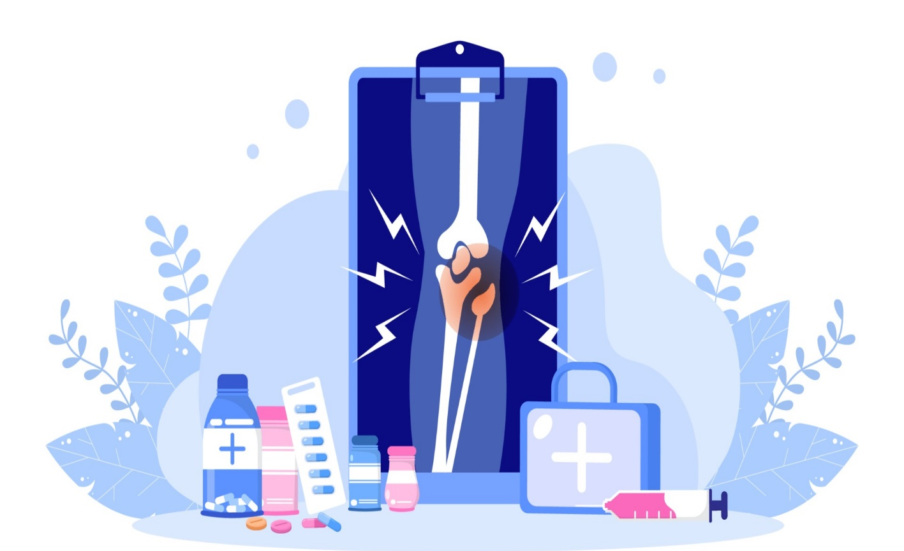
Introduction
IT18006544
What is Arthritis ?
Why we focus on Arthritis Disease?
02

Slide 4

Research Problem
Lack of assistance while getting drugs.
Unable to find the drugs' availability among pharmacies and buy the meds for a fair price.
The inability to read and manage handwritten prescriptions.
Information about lab reports and side effects is not clear enough to read and understand.

Slide 5
Overall System Diagram

Slide 6
Main Objectives
• The primary goal of our research is to develop an innovative mobile application that allows users to easily access and understand what drug names are prescribed on a doctor's prescription by utilizing many features.

Slide 7

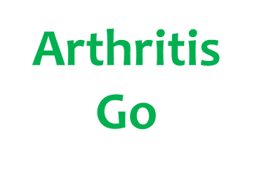
Sub Objectives
1. Digital Smart Pill Box
2. Monitor Best Pharmacy
3. Voice Based E- Prescription
4. Lab Report Analyzer & Drug Side Effects Predictor

Slide 8

Detecting Medical Covers and Automated
Visual Smart Box
IT19025322
Hewapathirana L.L
B.Sc. (Hons) Degree in Information Technology Specialization in Information Technology
01
IT19025322| Hewapathirana L.L | 2022-73

Slide 9
Research Gap
Background
Introduction
Research Problem
Objectives
IT19025322| Hewapathirana L.L | 2022-73

Slide 10
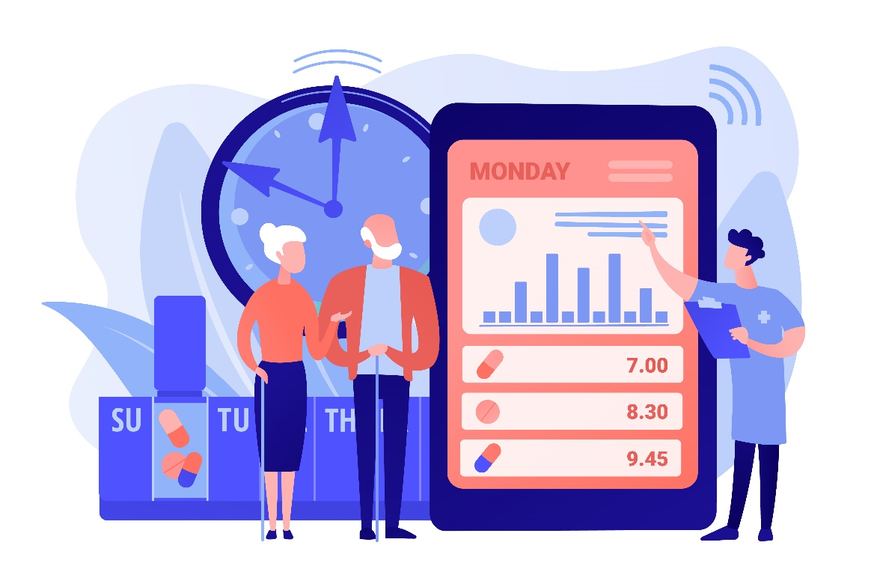
Background
In day today life arthritis people have trouble to maintain their medication routine.
People are looking forward to making their life more comfortable.
The digital smart pill box is a component that assists arthritis patients in receiving their medications in a convenient and secure manner.
The dispensary drug cover errors also can be identified accurately by using the smart pill box.
IT19025322| Hewapathirana L.L | 2022-73

Slide 11
Research Gap
Features | A | B | C | D | Proposed System
Digital Medicine Box for Arthritis | × | × | × | × | √
Alert to remind the certain medicine and confirm function | √ | √ | √ | √ | √
Alert before 2 days to refill the medicine containers | × | × | × | × | √
Count the number of pills in each container | √ | √ | √ | × | √
IT19025322| Hewapathirana L.L | 2022-73

Slide 12
Research Gap
Features | A | B | C | D | Proposed System
Notify the family member | √ | √ | √ | √ | √
Set the alarm notification to remind the next doctor visit | × | × | × | × | √
Upload pharmacy drug covers to app | × | × | × | × | √
Finding errors in Pharmaceutical covers | × | × | × | × | √
Compare the drug covers data with the prescription in the cloud | × | × | × | × | √
IT19025322| Hewapathirana L.L | 2022-73

Slide 13

Research Problem
How to track of taking the right drug at the right moment each day effectively?
How to distribute automatically correct number of pills dosage different days of the week?
How to extract data in drug coverage given by the pharmacy and compare it with prescription ?
IT19025322| Hewapathirana L.L | 2022-73

Slide 14
Objectives
IT18006544
Perera H.D.D.S
Main Objective
Introduce an innovative mobile application to arthritis patients to convert their traditional medication box into a digital smart medical box.
Sub Objective 1
Automatically display the number of bottles with the appropriate quantity of tablets.
Sub Objective 2
To monitoring the correctness of the medicine cover by comparing the prescription.
03
IT19025322| Hewapathirana L.L | 2022-73

Slide 15
System Diagram
Technologies
IT18006544
Perera H.D.D.S
Methodology
Requirements
Work Breakdown
03
IT19025322| Hewapathirana L.L | 2022-73

Slide 16
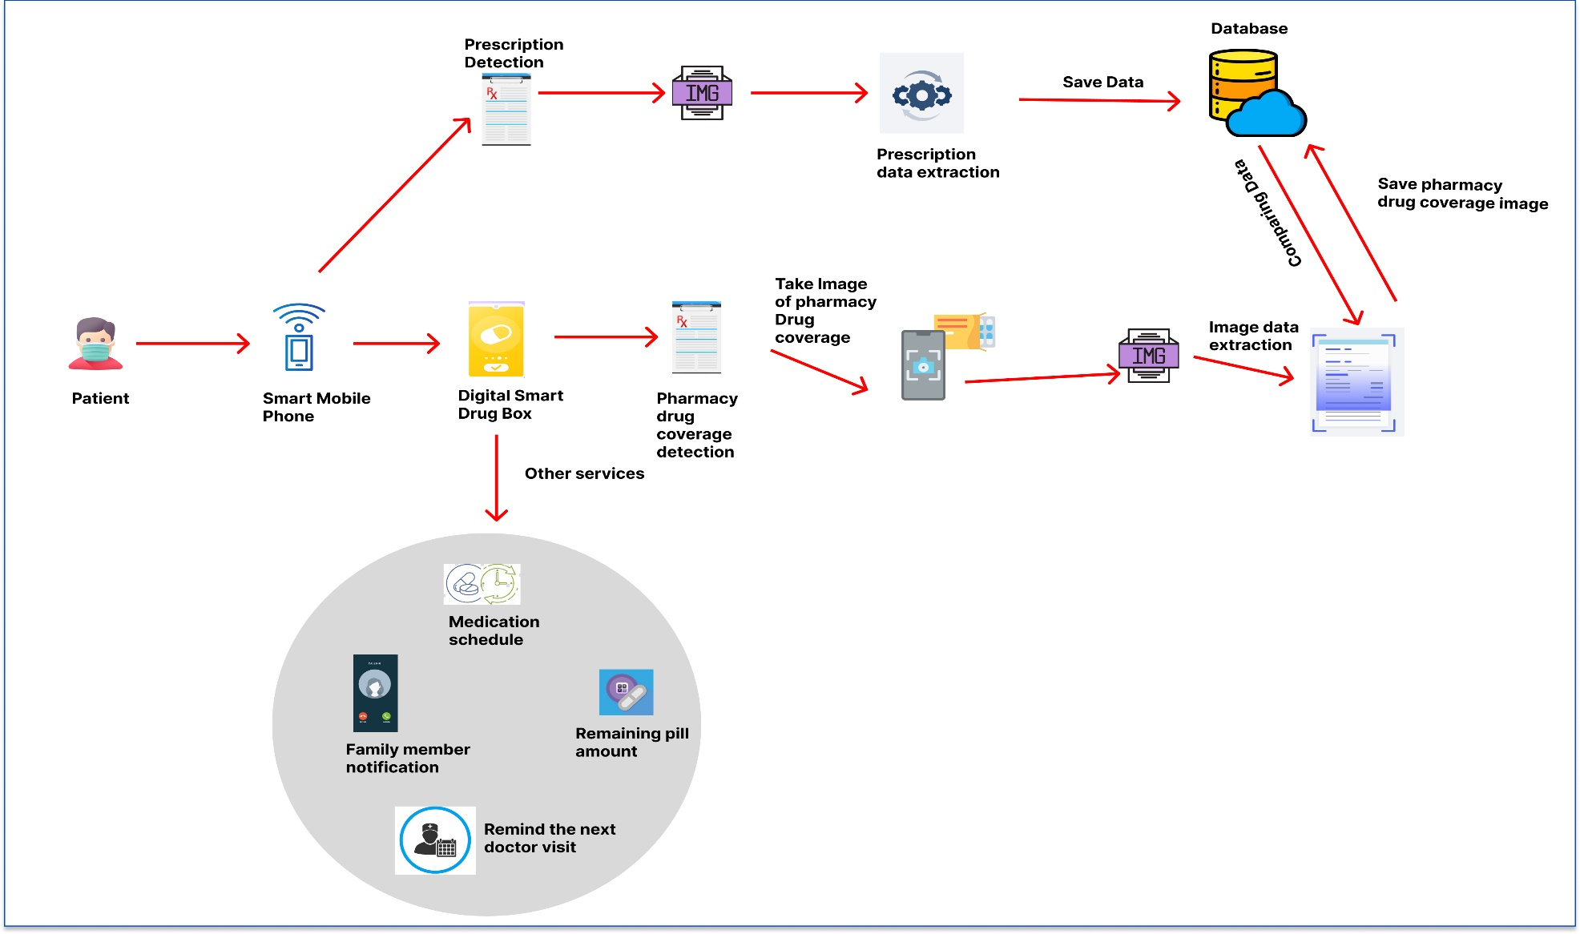
System Diagram
IT19025322| Hewapathirana L.L | 2022-73

Slide 17



Tools & Technologies
Node JS
AWS
Google Collab
React Native
Visual Studio IDE
Python Django REST API
Conventional Neural Network(CNN)
Artificial Neural Network (ANN)
Natural Language processing(NLP)
IT19025322| Hewapathirana L.L | 2022-73

Slide 18
Requirements
Functional Requirements
System should be able to extract the drug name, dosage and duration accurately from the medicine covers supplied by the pharmacy.
System must be able to compare the extracted data with the records stored in the database for confirm right drug
System must be able to provide alerts to the patients within the specified time.
System must be able to provide proper automated visual medical box with relevant data.
IT19025322| Hewapathirana L.L | 2022-73

Slide 19
Requirements
Non-Functional Requirements
High accuracy
Easy to use interface
Portability
Confidentiality
Availability
IT19025322| Hewapathirana L.L | 2022-73

Slide 20
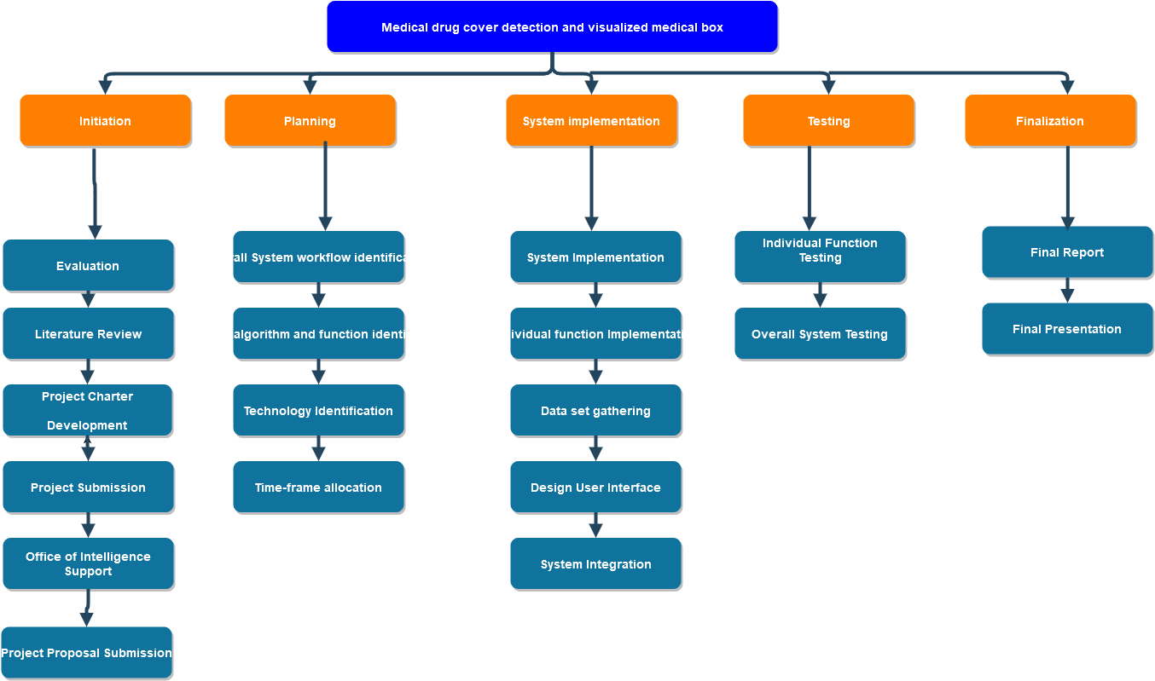
Work Breakdown
IT19025322| Hewapathirana L.L | 2022-73

Slide 21
References
[1] M. N. U. M. A. I. a. M. A. Mohammed Abdul Kader, "Design & Implementation of an Automated Reminder," 27-October-2018, Chittagong, Bangladesh, 2018.
[2] G. M. V. S. S. a. T. N. N. V. S. Rama Lakshmi Gali, "AUTOMATED MEDICINE BOX FOR," 2020.
[3] P. D. S. B. a. P. v. Dr.Sivakumar Sabapathy Arumugam, "Automated Medicine Dispenser in Pharmacy," International Journal of Advances in Computer and Electronics Engineering, India, 2019.
[4] K. G. a. A. R. Aakash Sunil Salgia, "Smart Pill Box," Indian Journal of Science and Technology,, vol. 8, no. January 2015, 2015.
[5] S. M. ,. J. M. S. M. M. R. T. T. Mohammed Abdul Kader, "Development of an Assistive Device for Elderly," IEEE, Dhaka, 2019.
[6] K. K. R. A. Z. D. A. H. J. B. Hiba ZEIDAN, "Smart Medicine Box System," IEEE, Lebonon, 2018.
IT19025322| Hewapathirana L.L | 2022-73

Slide 22
Finding Best Pharmacy
IT19955582
Mallawaarachchi T.S
B.Sc. (Hons) Degree in Information Technology Specialization in Information Technology
01
IT19955582| Mallaarachchi T.S | 2022-73

Slide 23
Research Gap
Background
Introduction
Research Problem
Objectives
IT19955582| Mallaarachchi T.S | 2022-73

Slide 24

Background
UHC by aiming to achieve “access to safe, effective, quality, and affordable essential medicines and vaccines for all”.
Lack of drugs
Rapidly changing prices of drug.
Existence of online pharmacies.
IT19955582| Mallaarachchi T.S | 2022-73

Slide 25
Research Gap
Features | A | B | C | D | Proposed System
identifying the drugs for arthritis using prescription detection | ✓ | ✖ | ✖ | ✖ | ✓
Connecting multiple pharmacies | ✖ | ✖ | ✖ | ✖ | ✓
Showing the nearest Pharmacies | ✓ | ✖ | ✖ | ✖ | ✓
Contact with pharmacy | ✓ | ✖ | ✓ | ✓ | ✓
predicting the suitable pharmacy | ✖ | ✖ | ✖ | ✖ | ✓
Storing the prescription in the database | ✓ | ✖ | ✓ | ✓ | ✓
IT19955582| Mallaarachchi T.S | 2022-73

Slide 26
Research Problem
How to check the availability of drugs ?
How to find required medications efficiently ?
How to get drugs at a reasonable cost ?
How to find a suitable pharmacy to buy ?
IT19955582| Mallaarachchi T.S | 2022-73

Slide 27
Objectives
IT18006544
Perera H.D.D.S
Main Objective
Finding quality medications and recommending the best pharmacy for the patient to buy.
Sub Objective 1
By comparing competitive prices and choosing the right quality and fast reachable pharmacy for buy.
Sub Objective 2
Offering the opportunity to buy with a comprehensive understanding of the drug.
03
IT19955582| Mallaarachchi T.S | 2022-73

Slide 28
System Diagram
Technologies
IT18006544
Perera H.D.D.S
Methodology
Requirements
Work Breakdown
03
IT19955582| Mallaarachchi T.S | 2022-73

Slide 29
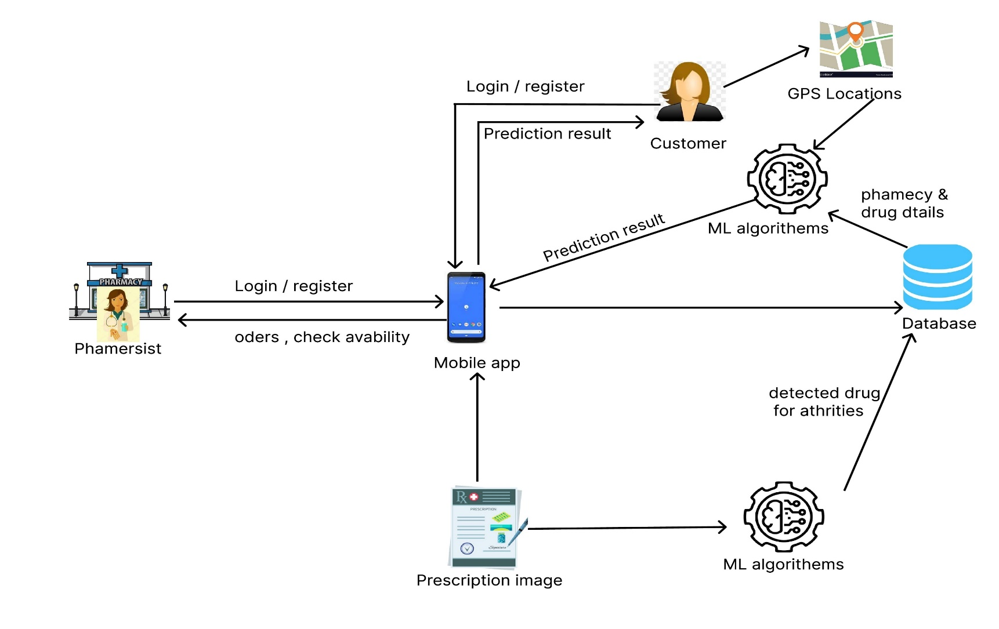
System Diagram
IT19955582| Mallaarachchi T.S | 2022-73

Slide 30
Tools & Technologies
Node JS
AWS
Google Collab
React native
Artificial neural network
Python Django rest API server
IT19955582| Mallaarachchi T.S | 2022-73

Slide 31
Requirements
Functional Requirements
Should be able to forecast the most suitable appropriate pharmacy.
Should be able to order drugs online using predictive pharmacy.
IT19955582| Mallaarachchi T.S | 2022-73

Slide 32
Requirements
Non-Functional Requirements
High accuracy
Easy to use interface
Portability
Confidentiality
Availability
IT19955582| Mallaarachchi T.S | 2022-73

Slide 33
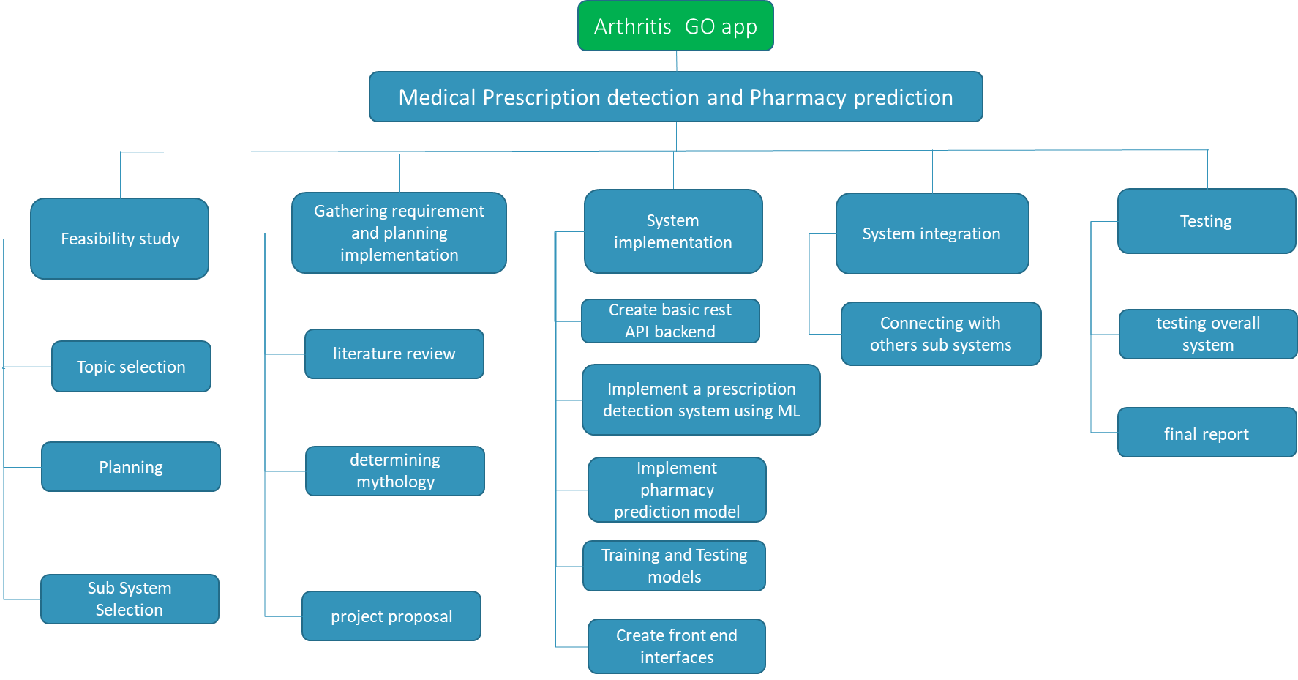
Work Breakdown
IT19955582| Mallaarachchi T.S | 2022-73

Slide 34
References
[1] H. H. Rahman, “online pharmacy management system,” 2020.
[2] N. S. Ahmad, M. H. Sanusi, M. H. Abd Wahab, A. Mustapha, Z. A. Sayadi and M. Z.
Saringat, "Conversational Bot for Pharmacy: A Natural Language Approach," 2018 IEEE
Conference on Open Systems (ICOS), 2018
[3] N. A. Kubra, N. Brundha, S. Nethra, V. Sivasakthi and R. Vasugi, "Mobile application
for checking the status of stock availability in pharmacy," 2017 International Conference on
Algorithms, Methodology, Models and Applications in Emerging Technologies
(ICAMMAET), 2017.
[4] N. S. Ahmad, M. H. Sanusi, M. H. Abd Wahab, A. Mustapha, Z. A. Sayadi and M. Z.
Saringat, "Conversational Bot for Pharmacy: A Natural Language Approach," 2018 IEEE
Conference on Open Systems (ICOS), 2018
IT19955582| Mallaarachchi T.S | 2022-73

Slide 35
Speech recognition to generate an electronic prescription.
IT19955414
Samaranayaka S.W
B.Sc. (Hons) Degree in Information Technology Specialization in Information Technology
01
IT19955414| Samaranayaka S.W | 2022-73

Slide 36
Research Gap
Background
Introduction
Research Problem
Objectives
IT19955414| Samaranayaka S.W | 2022-73

Slide 37
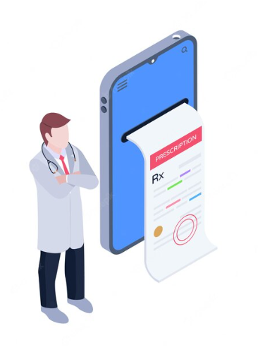
Background
Drug side effects are the leading cause of death in the world, according to a WHO study.
To solve this problem, our research proposes the development of a voice-based prescription generation system.
By using a voice base prescription system, patients can get various benefits.
IT19955414| Samaranayaka S.W | 2022-73

Slide 38



Research Gap
Features | Research A | Research B | Research C | Research D | Research E | Proposed System
Generating voice-based prescription
Unique only for Arthritis patients
Sending the prescription to the patient as pdf format
The drug name is automatically suggested
Applying a digital signature in the prescription
Ensure high accuracy about the drug name
Storing the prescription in the database
IT19955414| Samaranayaka S.W | 2022-73

Slide 39
Research Problem
Isn’t that hard to understand hand written prescriptions ?
What are the main difficulties of using hand written prescriptions ?
How electronic prescription can be beneficial for a patient?
IT19955414| Samaranayaka S.W | 2022-73

Slide 40
Objectives
IT18006544
Perera H.D.D.S
Main Objective
Designing a Speech Electronic Prescription System Based on Mobile device
Sub Objective 1
Using natural language processing model to convert audio file to text format.
Sub Objective 2
By automatically suggesting the name of the drug through the prescription form, the doctor can confirm its correctness.
Sub Objective 3
Patients will be able to get the prescription directly through their mobile phone.
03
IT19955414| Samaranayaka S.W | 2022-73

Slide 41
System Diagram
Technologies
IT18006544
Perera H.D.D.S
Methodology
Requirements
Work Breakdown
03
IT19955414| Samaranayaka S.W | 2022-73

Slide 42
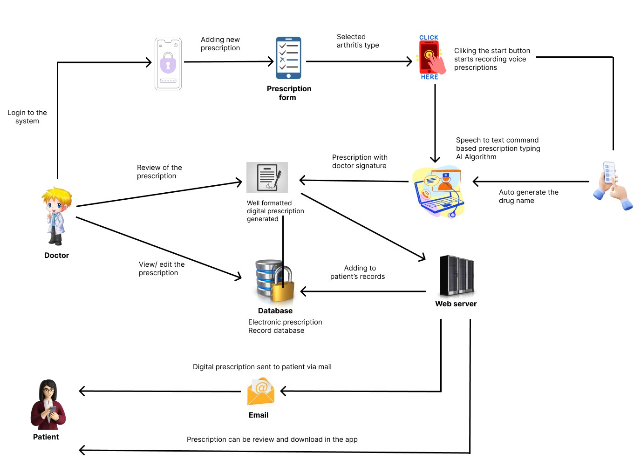
System Diagram
IT19955414| Samaranayaka S.W | 2022-73

Slide 43
Tools & Technologies
Node JS
AWS
Google Collab
React Native
Natural Language processing(NLP)
Python Django REST API Server
Google speech to text API
Visual Studio IDE
Firebase
IT19955414| Samaranayaka S.W | 2022-73

Slide 44
Requirements
Functional Requirements
Should be Use the Google Speech API as a identify all disease names.
Should be able to Apply a digital signature in the prescription.
A list of drug names is automatically generated.
Should be able to send well organized prescription to patient email.
IT19955414| Samaranayaka S.W | 2022-73

Slide 45
Requirements
Non - Functional Requirements
Availability
Reusability
Usability
Performance
IT19955414| Samaranayaka S.W | 2022-73

Slide 46
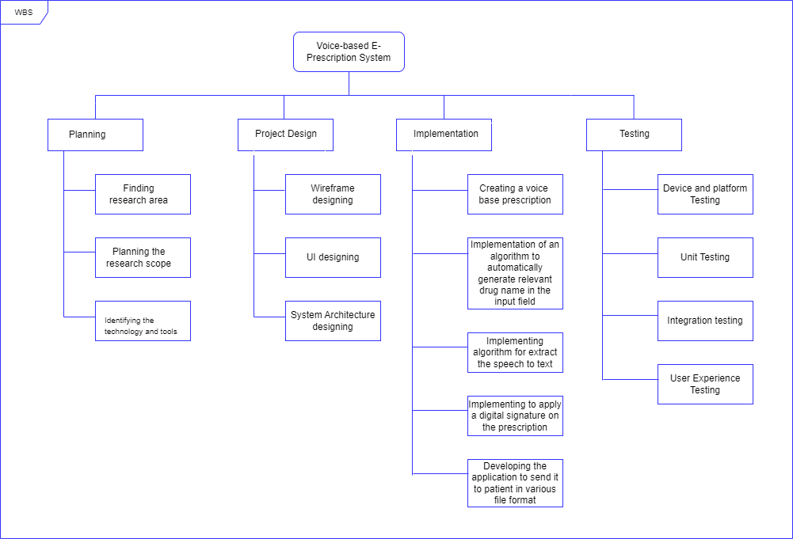
Work Breakdown
IT19955414| Samaranayaka S.W | 2022-73

Slide 47
References
[1] Ms. B. Priya ,Associate Professor, Department of Computer Science and Engineering Sri Sairam Engineering College Ms. Padma Priya A , Engineer trainee, SIFY Technologies Ltd, Chennai Ms. Bharathi R,Intern, NPTEL, IIT Madras, “Physician Voice Automated Prescription Generator And Management System,” 2020.
[2] Choudhary, Kuldeep and Agrawal, Tanmay and Dama, Ridhi and Rathod, Mansing, Voice Based E-Prescription (May 7, 2021). Proceedings of the 4th International Conference on Advances in Science &Technology(ICAST2021),Available SSRN: https://ssrn.com/abstract=3867317 or http://dx.doi.org/10.2139/ssrn.3867317
[3] M. V. Abhishek Gowda, Krithika Jagannath, Ashish K Amar, G. Meghana and Dr. Rekha B Venkatapur Department of Computer Science and Engineering Kammavari Sangha Institute of Technology, Bangalore, Karnataka, “Voice Based E-Prescription: A System for Appointment Booking, Prescribing and EHR,” 2021, p. 11.
IT19955414| Samaranayaka S.W | 2022-73

Slide 48

Evaluating Lab Reports and Monitoring the Side effects of drugs.
IT19146270
Jayangika D.H.K.C
B.Sc. (Hons) Degree in Information Technology Specialization in Information Technology
01

Slide 49
Research Gap
Background
Introduction
Research Problem
Objectives
IT19146270| D.H.K.C Jayangika | 2022-73

Slide 50
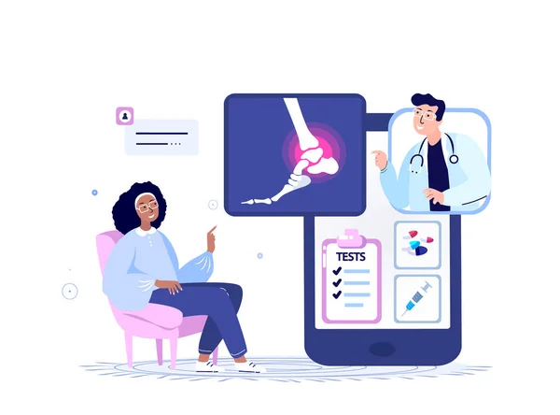
Background
Patients are giving less attention to their diseases nowadays due to all the problems that are present. Due to this reason, patients must face various problems.
The level of arthritis can be accurately determined by laboratory results using our mobile application without a medical appointment.
Providing a proper solution to identify arthritis drug side effects.
IT19146270| D.H.K.C Jayangika | 2022-73

Slide 51


Research Gap
Features | Research A | Research B | Research C | Research D | Research D | Proposed System
Arthritis Lab report data extract and analysis the disease level.
Display the disease level using graph
Display the difference in disease levels from month to month using a graph
Patients can get the uploaded lab report
Predict arthritis drug side effect
Display The Health Tips avoid the drug side effect
IT19146270| D.H.K.C Jayangika | 2022-73

Slide 52

Research Problem
How can laboratory reports accurately diagnose arthritis levels?
How to identify side effects of drugs used to treat arthritis Correctly?
How to properly determine the actions necessary to avoid drug side effects?
IT19146270| D.H.K.C Jayangika | 2022-73

Slide 53
Objectives
Main Objective
Introduce Mobile vision-based technology to analyze laboratory results for arthritis diseases and monitor drug side effects
Sub Objective 1
Lab report data analyze and display the disease level
Sub Objective 2
Display the difference in disease levels from month to month.
Sub Objective 3
Monitoring the side effects of heavy drugs and Displaying the Health Tips to avoid the drug side effect.
03
IT19146270| D.H.K.C Jayangika | 2022-73

Slide 54
System Diagram
Technologies
IT18006544
Perera H.D.D.S
Methodology
Requirements
Work Breakdown
03
IT19146270| D.H.K.C Jayangika | 2022-73

Slide 55
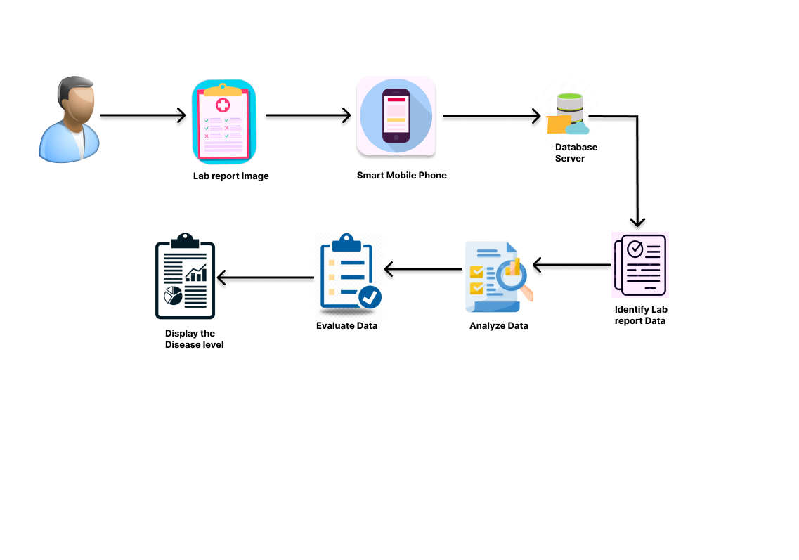
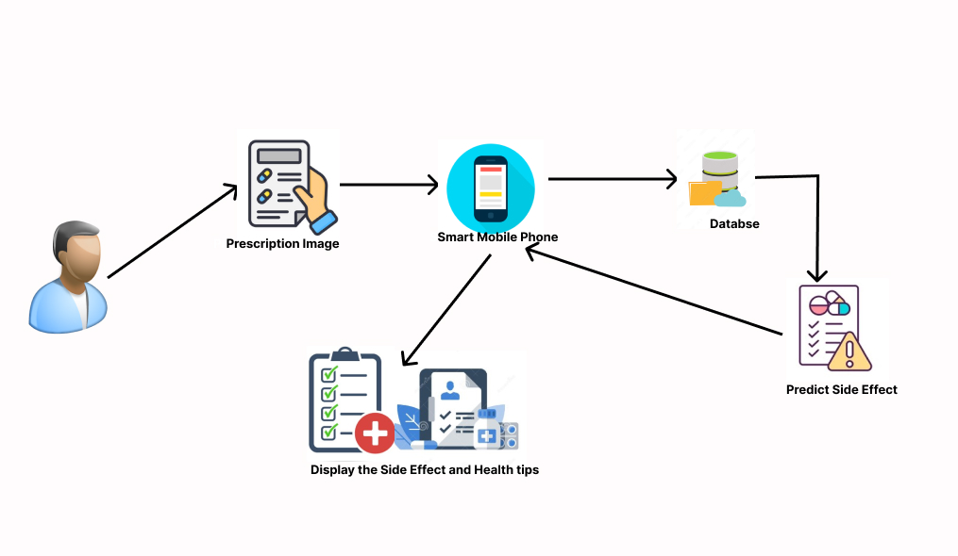
System Diagram
Laboratory Report Data Identify and Analysis
Monitoring the side effects of heavy drugs
IT19146270| D.H.K.C Jayangika | 2022-73

Slide 56
Tools & Technologies
Node JS
AWS
Google Collab
React Native
Natural Language processing(NLP)
Python Django REST API
Visual Studio IDE
Conventional Neural Network(CNN)
Artificial Neural Network (ANN)
IT19146270| D.H.K.C Jayangika | 2022-73

Slide 57
Requirements
Functional Requirements
Depending on the type of arthritis, patients taking drugs for it should be able to view the drug's side effects in the prescription.
To prevent the drug's side effects, the patient should be able to see the necessary health instructions.
The decrease and increase of arthritis should be accurately displayed to the patient depending on the type of arthritis.
Increases and decreases in arthritis should be shown month by month.
IT19146270| D.H.K.C Jayangika | 2022-73

Slide 58
Requirements
Non-Functional Requirements
Availability
Reusability
Readability
Performance
IT19146270| D.H.K.C Jayangika | 2022-73

Slide 59
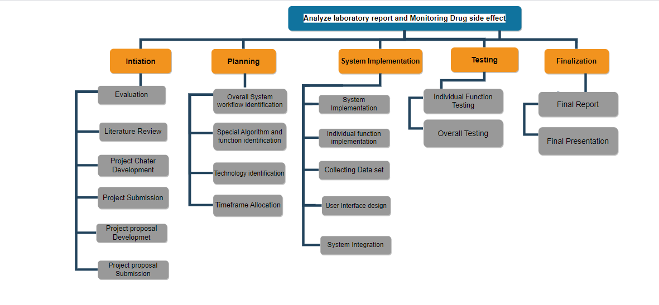
Work Breakdown
IT19146270| D.H.K.C Jayangika | 2022-73

Slide 60
References
[1]F. L. L. L. &. J. Z. Wen Zhang, "Predicting drug side effects by multi-label learning and ensemble learning," p. 11, 4 November 2015.
[2] Testing.com, "Testing.com," A ONECARE [2]MEDIA COMPANY., [Online]. Available: https://www.testing.com/arthritis-testing.
[3] F. R. Adam Feather MBbs, Kumar and Clark's Clinical Medicine 10th Edition, London New york: Adam Feather MBbs, Facadmed,David RandallMA,MRCP, 2021.
[4]1. M. W. P. H. L. Y.-J. K. Y. K. a. Y. H. P. a. Dong Jin Park, "Development of machine learning model for diagnostic disease prediction based on laboratory tests," Scientific report, 2021.
IT19146270| D.H.K.C Jayangika | 2022-73

Slide 61
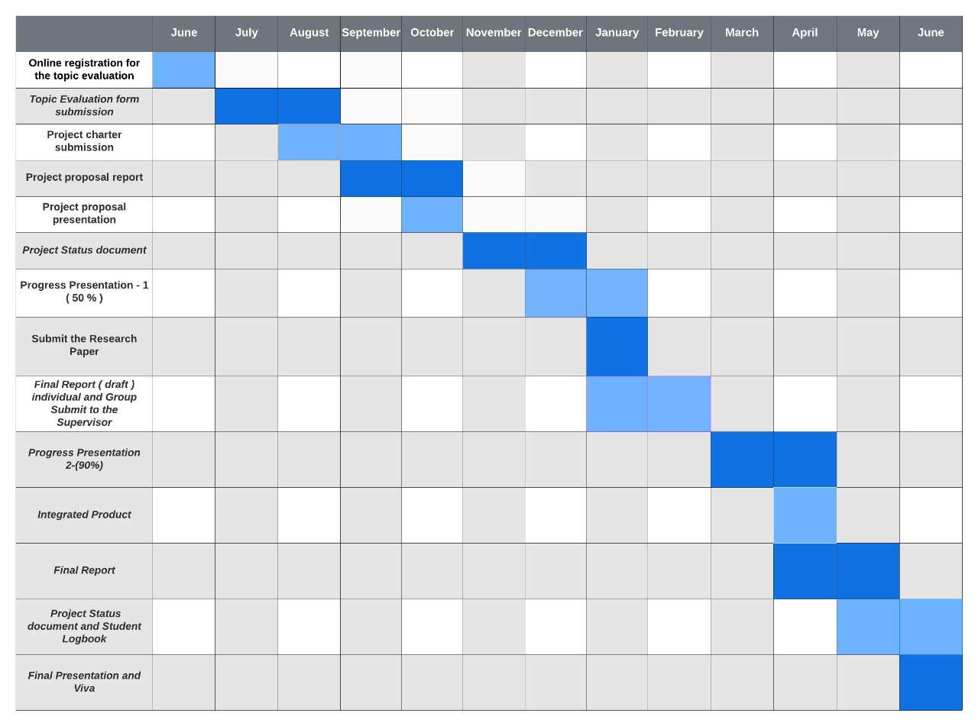
Gantt Chart

Slide 62
Commercialization Plan
Support Items
Budget Plan

Slide 63
Commercialization Plan
Create Social media marketing plan.
Recognizing arthritis patient audience.
Developed a pricing strategy.
Creating a public relation and news media strategy.

Slide 64

Budget for the overall system
IT18001112
Tharaka
W.C.M.K.
Resource | Price (LKR)
AWS Cloud | 2000.00
Internet Cost | 4000.00
Documentation | 2000.00
Stationary | 1000.00
Traveling Cost | 3000.00
Total Cost | 12000.00
32

Slide 65


IT18001112
Tharaka
W.C.M.K.
33

